Slide 1
FACTORING TRINOMIALS
A > 1

Slide 2
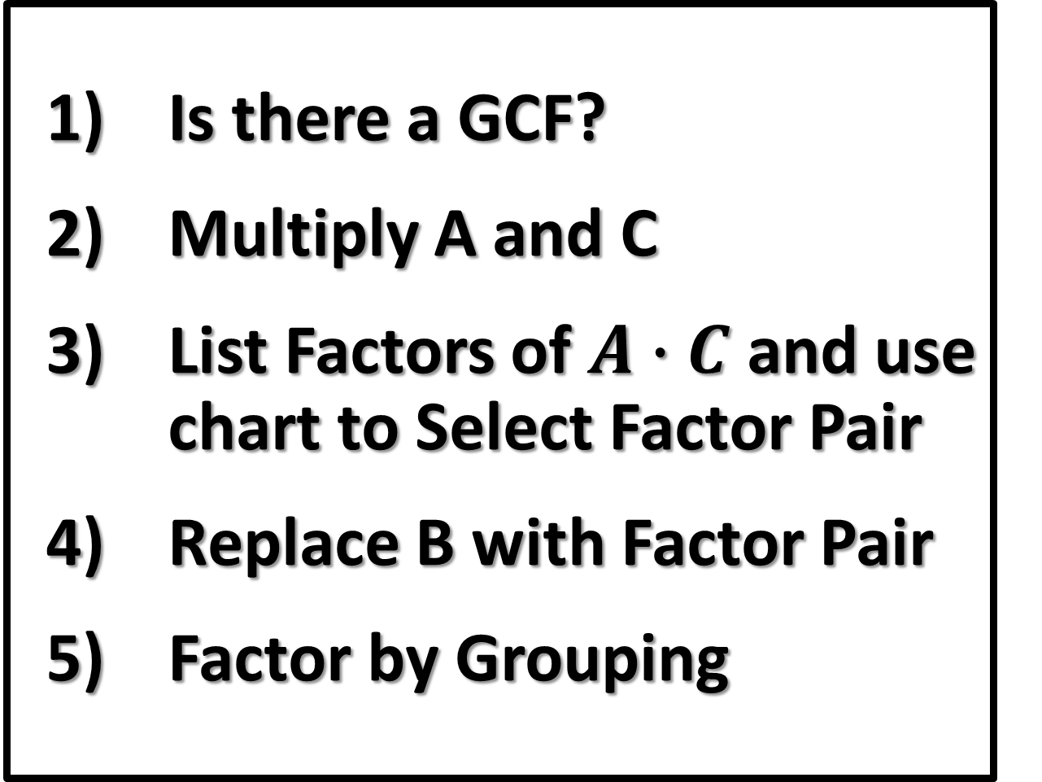

Factoring a Trinomial
$${Ax}^{2}+Bx+C$$
  Is there a GCF?
  Multiply A and C
  List Factors of $A∙C$ and use chart to Select Factor Pair
  Replace B with Factor Pair
  Factor by Grouping

Slide 3
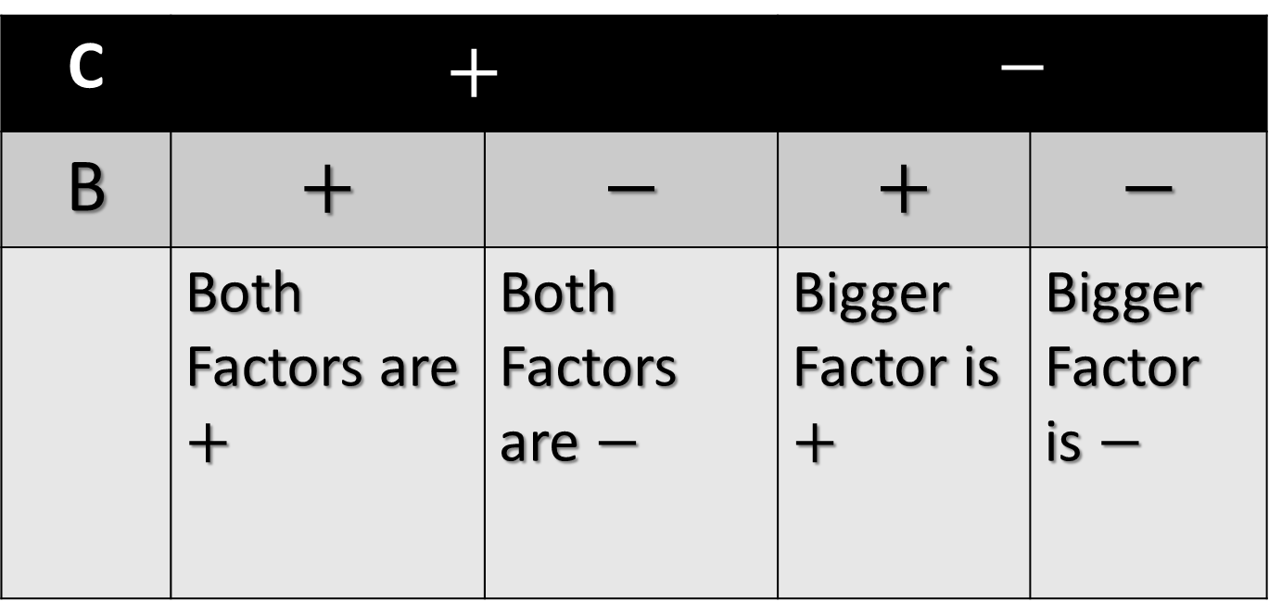
SIGN CHART
C | $$+$$ |  | $$−$$
B | $$+$$ | $$−$$ | $$+$$ | $$−$$
 | Both Factors are $+$ | Both Factors are $−$ | Bigger Factor is $+$ | Bigger Factor is $−$

Slide 4
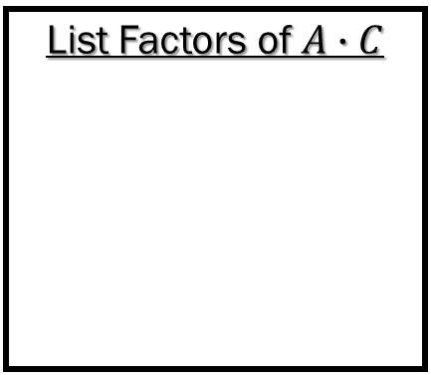

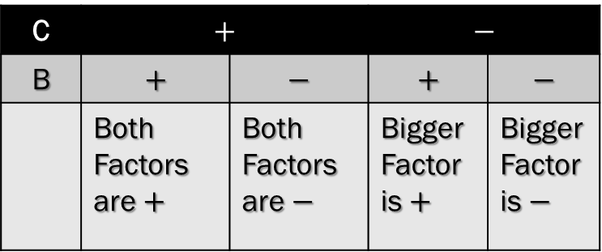
Factoring Trinomials of the Form ${Ax}^{2}+Bx+C$
Trinomial to Factor
A VALUE
B VALUE
C VALUE
Is there a GCF?
Trinomial with GCF Factored Out
MULTIPLY A & C
C | $$+$$ |  | $$−$$
B | $$+$$ | $$−$$ | $$+$$ | $$−$$
 | Both Factors are $+$ | Both Factors are $−$ | Bigger Factor is $+$ | Bigger Factor is $−$
Use the Chart to Find the Factor Pair that Combines to B.
List Factors of $A∙C$
Replace B with Factor Pair
Factor By Grouping
Factored Polynomial

Slide 5
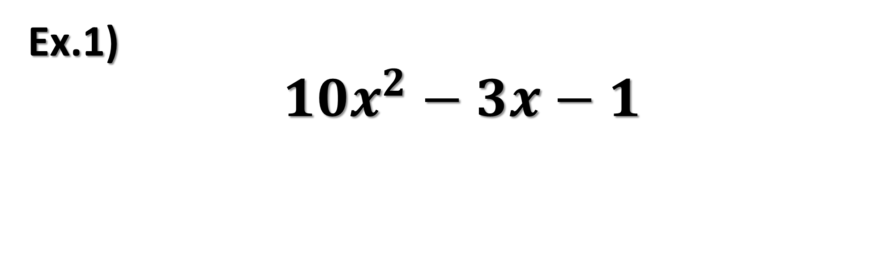
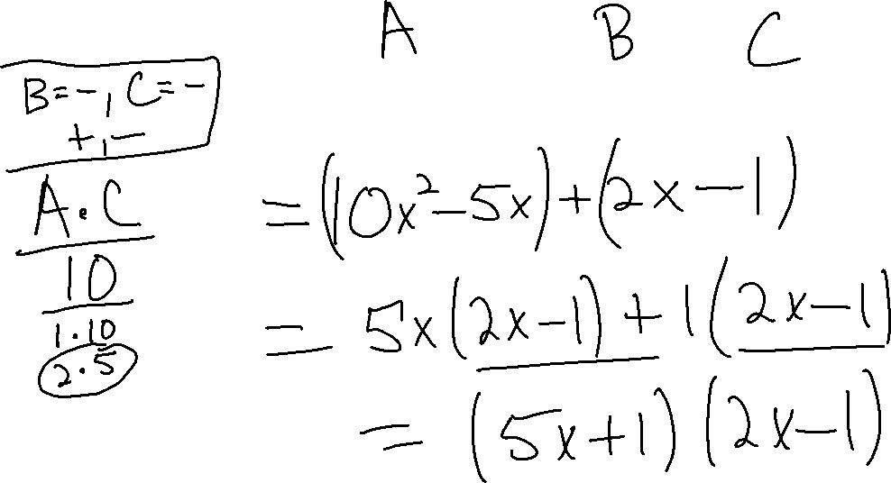
Ex.1)
$${10x}^{2}−3x−1$$

Slide 6
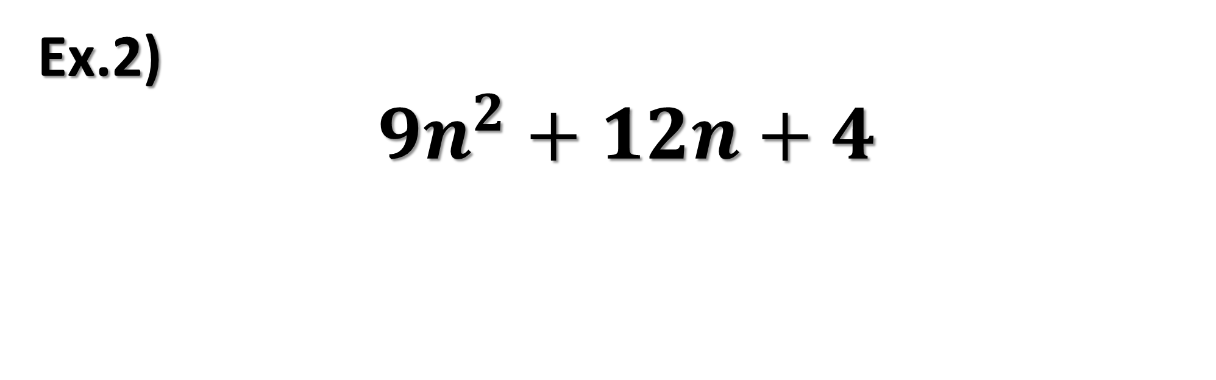
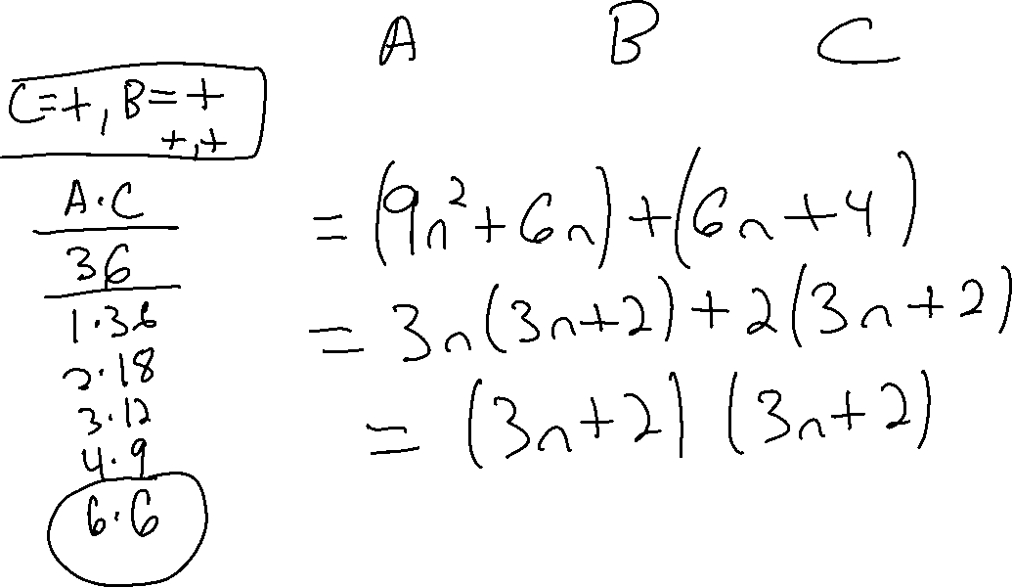
Ex.2)
$${9n}^{2}+12n+4$$

Slide 7
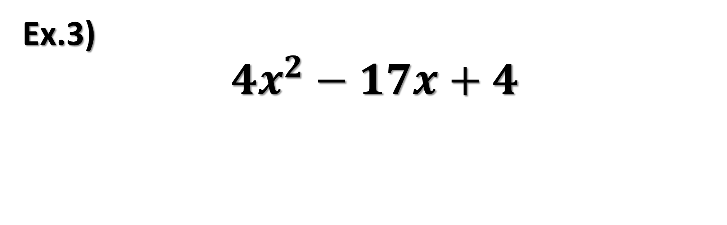
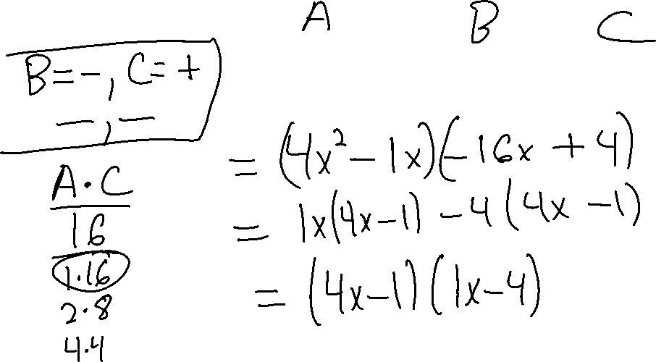
Ex.3)
$${4x}^{2}−17x+4$$

Slide 8
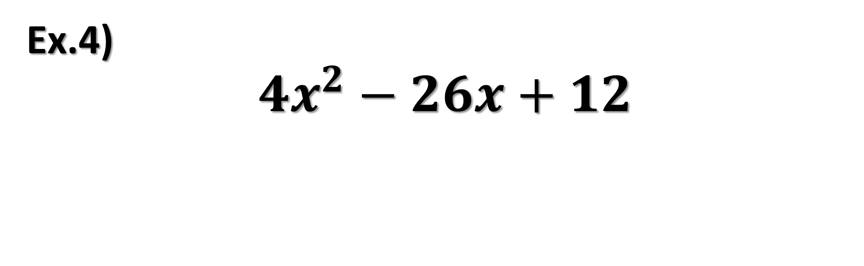
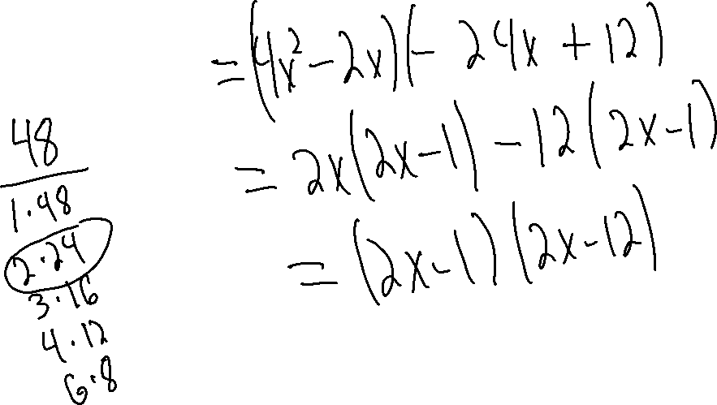
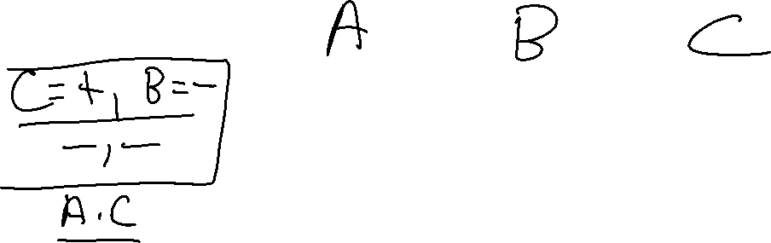
Ex.4)
$${4x}^{2}−26x+12$$

Slide 9


Try These
$${4x}^{2}+12x−7$$
$${4x}^{2}+9x−9$$

